Slide 1
Report of the Senior Pastor
Prepared by Rev. Tom Parkinson
for the Dutilh Townhall Meeting
April 8, 2024

Slide 2
“This is to my Father’s glory, that you bear much fruit, showing yourselves to be my disciples” (John 15:8)
Our mission – to make disciples of Jesus Christ who love God, love others, and love to serve.
If we are being faithful, our ministry should bear fruit.

Slide 3
The Fruit of Our Ministry in 2023
41 new members received
15 baptisms
70+ children involved in weekly children’s ministries
40+ students engaged by Student ministry
Record breaking flea market and VBS offerings, raising nearly $60,000
Development of lay-led ministries – G&G, men’s ministry, and faithful followers

Slide 4
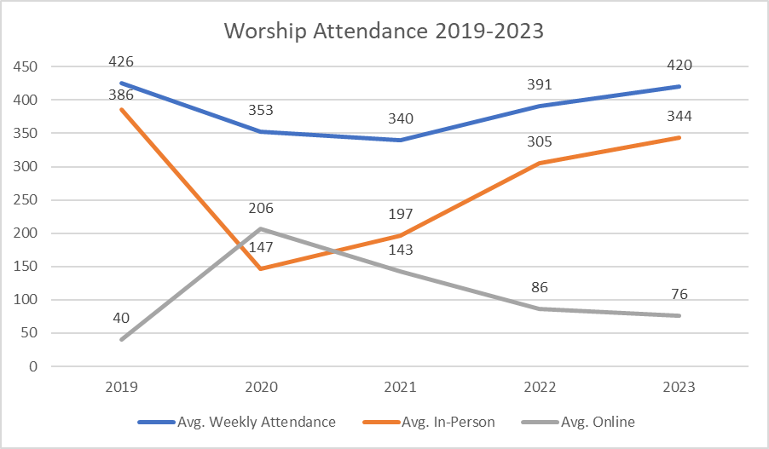

Slide 6
Future Challenges
Volunteer capacity & burnout
Pastoral & staffing needs
Children’s ministry space
Denominational identity

